Slide 1
Databases SQL
Introduction to SQL

Slide 2
Modelling

Slide 3
Designing the Database
Before we start creating a database, we should model it first and test it against any requirements we may already have.
For this we will be using an entity relationship diagram(ERD)
Consider:
What data it will be storing
Who will be using it
What the data will be used for
Do you have any documentation to work with already?

Slide 4
Designing the Database
Entity Type
An entity type is a class of objects.
Entities represented within an entity type have the same characteristics.
Entity
An entity could be an object, person, event or abstraction.
An entity must be relevant.
Could be referred to as an ‘instance’ of an entity type.
The Entity Type ‘Person’ has the entities ‘James’ and ‘Jo’

Slide 5
Objects First vs. Tables First
With Objects First you start by creating the code and then engineering the database later.
Libraries like Java EE’s JPA API provides a specification for reverse engineering database from code.
The advantage of this method is that we can change the database structure on the fly as it does not yet exist.
With Tables First you start by engineering the database and then creating the code later.
Cheaper if there is already an existing database or if there are multiple systems that will rely on the database.
The advantage is that we have a rigid structure in place and other developers know exactly what they are working with.

Slide 6
Entity Relationship Diagrams
ERDs are used to show the design of a database schema with names, columns and relationships.
The ERD focuses on the DATA not code objects.
When creating the ERD, think in terms of the end user, use your user stories to include the relevant data in a logical format.
Don’t include unnecessary information.
MySQL Workbench has a good ERD modelling tool built in that we will look at later

Slide 7
Cardinality – entity relationships
Symbol | Meaning
 | One and Only One
 | Zero or One
 | One to Many
 | Zero to Many

Slide 8
ERD Creation Steps
Identify the Entity
Identify the Attributes
Identify the Primary Keys
Identify the relationships
Identify the cardinality
Draw a Draft
Map the Attributes
Refine the ERD
Take your user stories.
Pick one.
Follow these steps using the information in the user story.
When you’ve finished step 8, Pick another one.
Repeat till there are no more user stories.
Most user stories will need to be looked at more than once.
Don’t add anything that isn’t in a user story.

Slide 9
1. Identify the Entity
“As a customer I want to find books by a specific author to find other works by that author I may be interested in.”
Here we can identify two entity types: Book and Author.

Slide 10
2. Identify the Attributes
“As a customer I want to find books by a specific author to find other works by that author I may be interested in.”
Here we can identify that for book we have an attribute of author.
Because we are looking at both entities we can also see that author has an implied attribute of name.
We don’t have to identify an attribute in every user story, this will be one of several stories so we aren’t expecting to find everything.

Slide 11
3. Identify the Primary Keys
“As a customer I want to find books by a specific author to find other works by that author I may be interested in.”
Some entities may not have a single attribute that is always unique.
In these cases we can think about whether or not we could use multiple attributes as a composite key.
Here we can identify that for book we don’t actually have a primary key that we can identify in this story.
We could make the assumption here that author’s identified attribute of name could be a primary key.
We don’t have to identify a primary key in every user story, this will be one of several stories so we aren’t expecting to find everything.

Slide 12
4. Identify the Relationships
“As a customer I want to find books by a specific author to find other works by that author I may be interested in.”
Here we can identify that there is a relationship between book and author.
Again, we aren’t expecting to find everything in one story.
We can create a Relationship Matrix to help us see the relationships.
Not every entity will have a relationship with every other entity.
 | Book | Author | Publisher
Book |  | Is Written By | Is Published By
Author | Writes
Publisher | Publishes

Slide 13
5. Identify the Cardinality
“As a customer I want to find books by a specific author to find other works by that author I may be interested in.”
A Book is written by One and Only One Author.
An Author writes One Or More Books.
Here we can identify that an author can write many books.
Because we can say that an author isn’t an author until they have written a book we can say that the relationship is One to Many.
We can write these out so that they are easy to see.
Later user stories may change the cardinality.

Slide 14
6. Draw the Draft
Book
Author

Slide 15
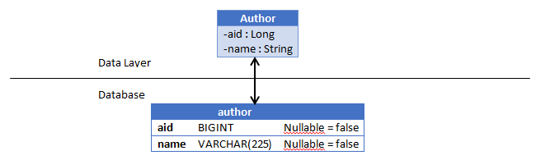
7. Map the Attributes

Slide 16
8. Refining the ERD
author
aid | BIGINT | 20
name | VARCHAR | 225
book
isbn | BIGINT | 13
title | VARCHAR | 300

Slide 17
Normalization
Normalization does a number of things for our database including:
Eliminating non-atomic values that impact performance or require complex code.
Eliminating redundant data.
Removes modification anomalies.
The aim is to organise our database to minimise data redundancy.
Tables should generally be normalised to the third normal form and the normal form of a database is the lowest normal form of all its tables.
Normalization should be done when we are still creating our ERD.

Slide 18
First Normal Form
Tables MUST have a key that all attributes depend on.
Every column stores ONLY atomic values.
cust_ID | fName | lName | phoneNumber
123 | Robert | Ingram | 012767128282
546 | Jane | Wright | 037197118422 0781551627
756 | Maria | Fernandez | 091641247291
If we are recording telephone numbers and a customer has two numbers we need a way of storing this.
We cant allow phoneNumber to contain more than one value as this would not conform to 1NF!
To Conform with 1NF we must add a new row to allow for multiple phone numbers
cust_ID | fName | lName | phoneNumber
123 | Robert | Ingram | 012767128282
546 | Jane | Wright | 037197118422
546 | Jane | Wright | 0781551627
756 | Maria | Fernandez | 091641247291

Slide 19
Second Normal Form
The Whole Key,
Must meet all requirements of First Normal Form
Non-prime attributes must not depend on a subset of any candidate key. No partial dependency
If we were to take our phone number table phoneNumber is dependent on a subset of the primary key: fName and lName
By separating these into separate tables we now conform to 2NF and 1NF
cust_ID | fName | lName | phoneNumber
123 | Robert | Ingram | 012767128282
546 | Jane | Wright | 037197118422
546 | Jane | Wright | 0781551627
756 | Maria | Fernandez | 091641247291
cust_ID | phoneNumber
123 | 012767128282
546 | 037197118422
546 | 0781551627
756 | 091641247291
cust_ID | fName | lName
123 | Robert | Ingram
546 | Jane | Wright
756 | Maria | Fernandez

Slide 20
Third Normal Form
And Nothing but the Key.
Must conform to 1 & 2NF
All non-prime attributes must not be transitively dependent on every key of R
Transitive dependency is where X determines Z indirectly because X determines Y and Y determines Z (X -> Z because X -> Y -> Z)
In this example Tournament and year determines winner DOB indirectly through winner.
Tournament | Year | Winner
Indiana Invitational | 1998 | Al Fredrickson
Cleveland Open | 1999 | Bob Albertson
Des Moines Masters | 1999 | Al Fredrickson
Indiana Invitational | 1999 | Chip Masterson
Tournament | Year | Winner | Winner DOB
Indiana Invitational | 1998 | Al Fredrickson | 21 July 1975
Cleveland Open | 1999 | Bob Albertson | 28 September 1968
Des Moines Masters | 1999 | Al Fredrickson | 21 July 1975
Indiana Invitational | 1999 | Chip Masterson | 28 September 1968
Winner | Winner DOB
Al Fredrickson | 21 July 1975
Bob Albertson | 28 September 1968
Chip Masterson | 28 September 1968

Slide 21
Higher Normal Forms
Boyce-Codd Normal Form (BCNF)
Fourth Normal Form
Fifth Normal Form
Domain-Key Normal Form
Sixth Normal Form

Slide 22
Denormalization
Denormalization is done after the database has been normalised.
It can improve read performance of a database if you have created many separate tables causing multiple joins to slow down operations.
It can also be useful if you are migrating some data to another type of database such as MongoDB.

Slide 23
Workbench Modelling

Slide 24
MySQL Workbench Modelling
Workbench is a user interface you can use to interact with your MySQL server
You can set up MySQL to run as a Windows service in the background
The first page you will see allows you to create many different things:
Connections – these are connections to a MySQL server that will hold your information
Models – these are the ERDs we discussed earlier
Scripts – these can be collections of SQL queries in order to get information

Slide 25
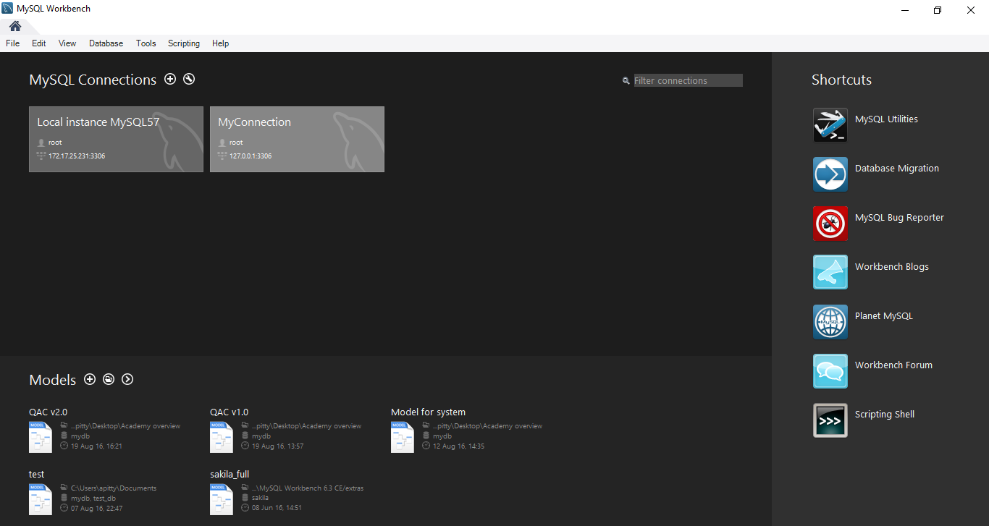
MySQL Workbench Modelling

Slide 26
MySQL Workbench Modelling
To create a new model you can just click on the plus button near the Models section or open up a model to see its current state
You can then click on New Model to create your new ERD or EER diagram (extended entity relationship diagram)
From here you will be presented with a grid on which to place your tables and make your database model
You can then forward engineer these models which will then generate SQL scripts in order to create the database in MySQL

Slide 27
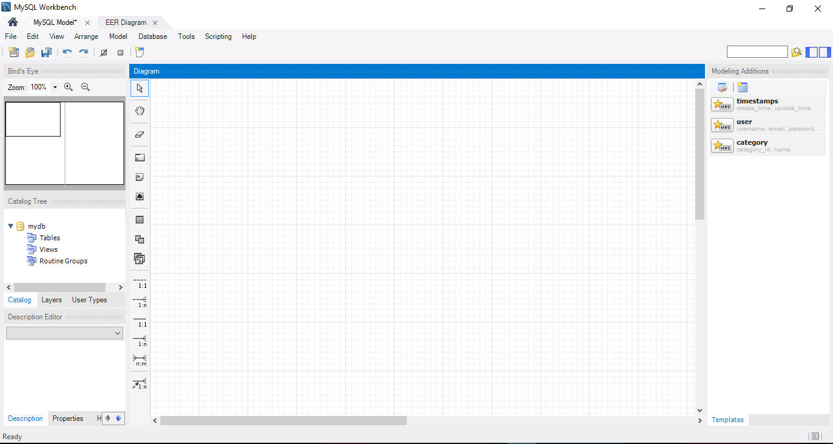
Notes:
Catalog tree – can open up each of these areas to see things in a tree diagram
Canvas to add tables etc to
Use the buttons down the side of the canvas to click and place things on the canvas

Slide 28
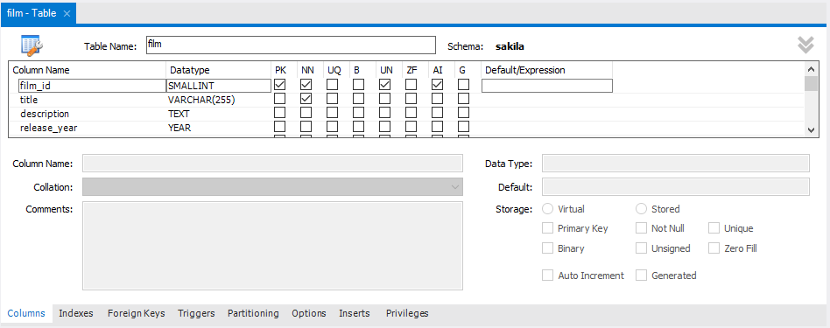
Double-click on a table to bring up an editing tab
Notes:
Give it a name
Add columns and specify constraints, data types etc

Slide 29
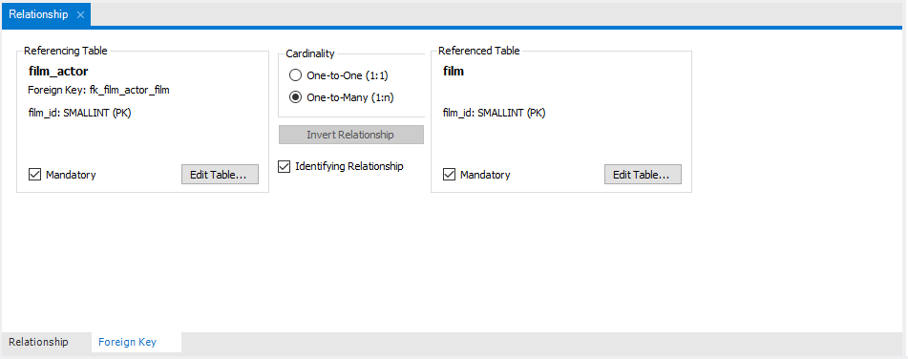
Double-click on a relationship to bring up an editing tab
Notes:
Give it a name
Add columns and specify constraints, data types etc

Slide 30
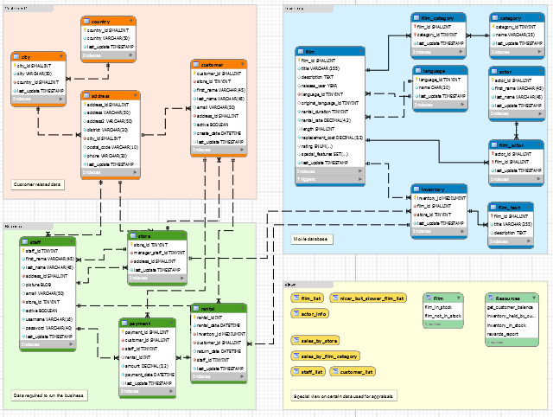
MySQL ships with a good example of a database model – the sakila data
First thing you will notice is the different coloured sections – these are layers and are a way of organising our data
Here we have Views, Customer data, Inventory (movie) data, and Business data

Slide 31
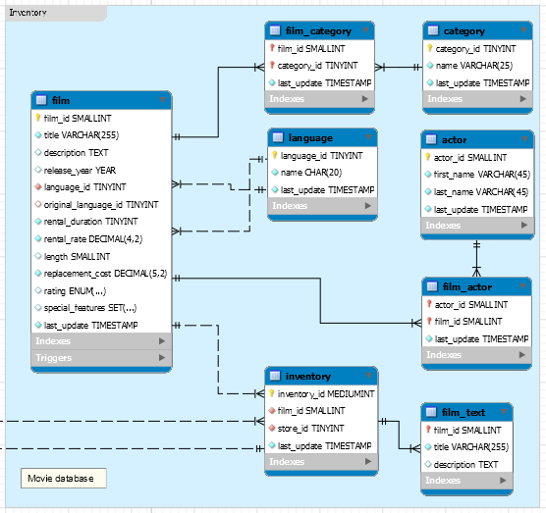
Let’s look in detail at the movie layer but be aware it has connections to other layers too
Solid black lines represent identifying relationships, dashed lines represent non-identifying relationships
The difference is identifying relationships mean that the primary key of the parent is also part of the primary key of the child

Slide 32
Look specifically at the film_actor table – it’s primary key will be a composite key of the actor_id and film_id – the primary keys from the parent tables
This essentially means that the film_actor cannot have an instance that does not include a valid key that matches up with the film and actor tables

Slide 33
The film_actor table is essentially acting as a bridge between films and actors since this would be a many-to-many relationship
MySQL would put these here automatically if you tried to create a m:m relationship
However we’ve also given it a unique piece of information called last_update so we know when it’s been updated for that record

Slide 34
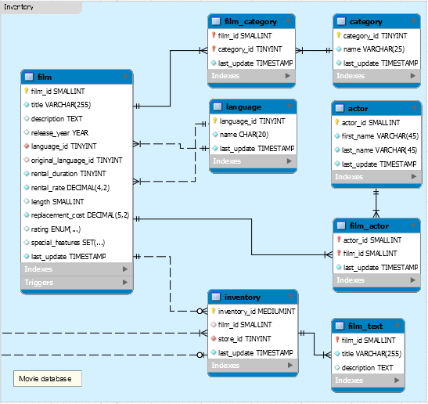
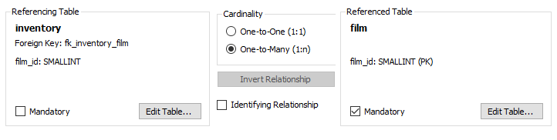
You can change the relationships to have 0 – 1 or 0 – many relationships as well
You can change this in the relationship editing table

Slide 35
Each column in a table has a symbol next to it so you can easily identify what sort of field it is
Primary key
Primary key that is also a Foreign Key
NOT NULL Attribute
NOT NULL Foreign Key
Attribute which can be NULL
Foreign Key which can be NULL
Notes:
Essentially a foreign key will be part of the primary key if it is an identifying relationship, it will just be a foreign key if it is not identifying

Slide 36
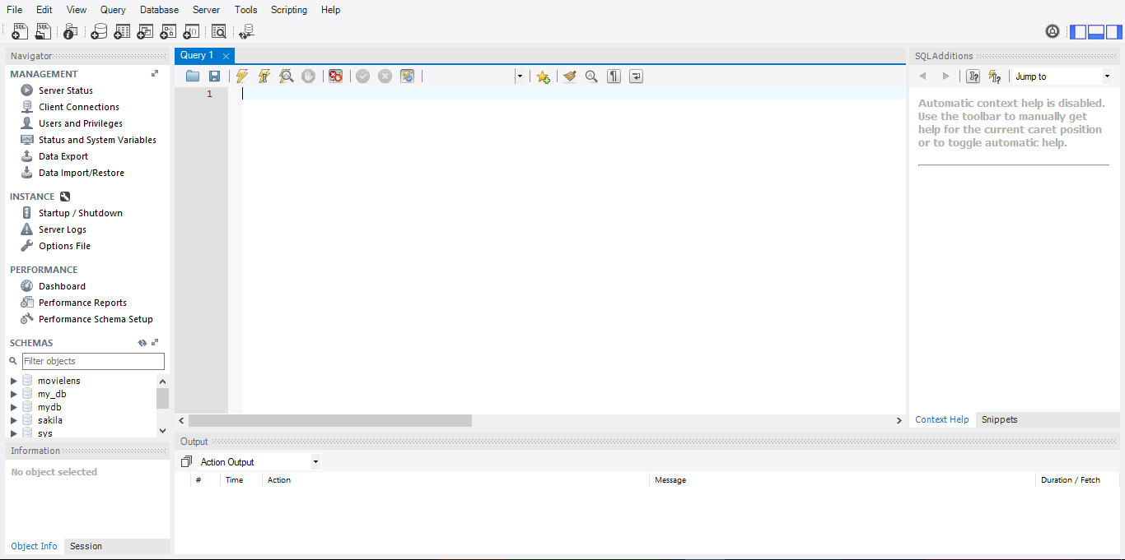

Slide 37
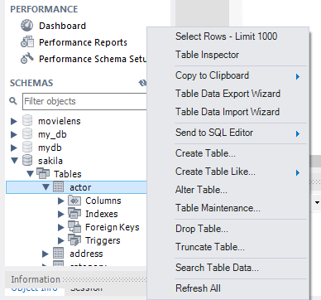
You’ll notice in schemas you can expand each of the sections of your databases, all the way down to the columns
If you right click on it you can get a number of additional options such as returning the first 1000 rows – a quick and easy way of getting an idea of what’s in your table

Slide 38
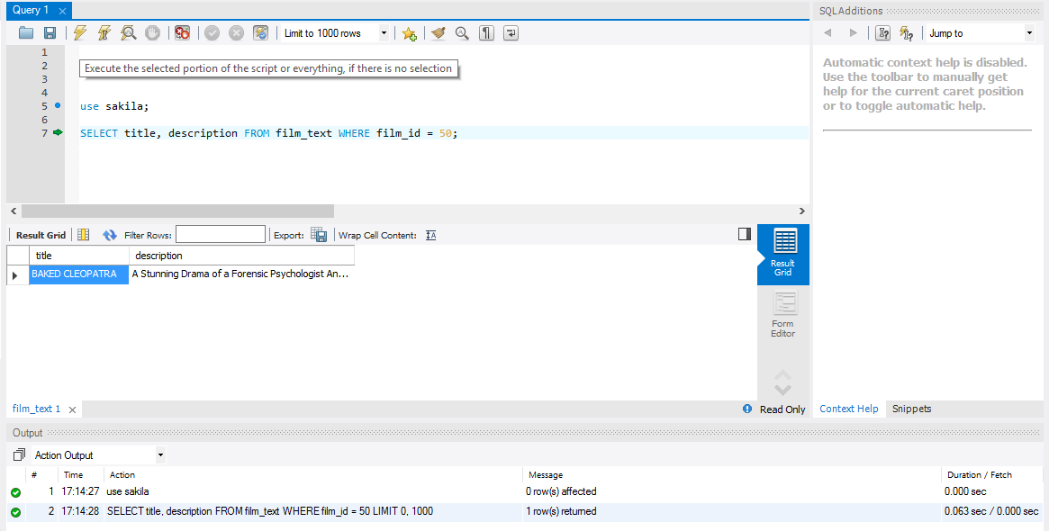

Slide 39
Operational Database
Generally a business will have an ‘operational’ database – this is where all the ‘current’ data is stored that the business processes require to function
This would be an OLTP (On-Line Transaction Processing) database
Main aim is to have quick query processing where many different people may be accessing the data
Characterised by a large number of short INSERT, UPDATE, or DELETE commands
Effectiveness measured by number of transaction per second

Slide 40
Data Warehouse
Operational databases are used for current transactions and undergo frequent changes
Data warehouses provide us with historical, consolidated data
The data warehouse often contains data from many sources which can be OLTP databases
A data warehouse equips us with OLAP (On-Line Analytical Processing) capabilities

Slide 41
Data Warehouse
Key features
Subject oriented
Not focussed on ongoing business operations but more a ‘subject’ of it e.g. products, sales…
Integrated
Integrates data from a range of other sources for effective analysis
Time Variant
Historical data from different times
Non-volatile
Previous data is not erased when new data is added

Slide 42
Operational Database
Generally a business will have an ‘operational’ database – this is where all the ‘current’ data is stored that the business processes require to function
This would be an OLTP (On-Line Transaction Processing) database
Main aim is to have quick query processing where many different people may be accessing the data
Characterised by a large number of short INSERT, UPDATE, or DELETE commands
Effectiveness measured by number of transaction per second

Slide 43
OLTP
Master data transactions
Business Processes
Business Strategy
Operations
OLAP
Decision making
Information
Data mining
Analytics
Data Warehouse

Slide 44
OLTP | OLAP
Operational data (day to day) | Consolidated data from various sources (historical)
Controls and runs fundamental business activities | Planning, problem solving, decision making
Short and fast inserts, updates, and standard, simple queries from users in order to return small amount of data (data in) | Periodic, long-running batch jobs, complex queries involving aggregation
Typically fast | May take many hours
Space required can be quite small if regularly archived | Larger amount of space required
Highly normalised | Typically denormalised with fewer tables, may use schemas such as star or snowflake
Back up frequently as the data is vital for business operations | May simply reload data from OLTP as a recovery method, less frequently back up
OLTP & OLAP

Slide 45
Data Warehouse
Data warehouses tend to lean towards dimensional modelling rather than relational modelling, which is a step towards OLAP cubes
We will explore a few of these schema types and we can create these within MySQL the same as others, it is simply a useful structure and a different way of thinking through the data

Slide 46
Data warehousing tables
Fact table
Measurements, metrics, or facts of a business process
Usually consists of a few foreign keys and a few additional fact attributes
Primary key is usually a composite made up of all of its foreign keys
Often just made of numerical attributes
Usually very long i.e. there will be lots of records contained within, but quite thin i.e. not very many columns
A fact table is quite similar to the tables created for many-to-many relationships that we’ve seen earlier!

Slide 47
Data warehousing tables
Dimension table
Categorises facts, essentially providing labels for the fact table
Often used for ‘slice and dice’ operations. Slicing filters data, Dicing groups the data
Usually have more descriptive elements compared to a fact table e.g. text comments
Will have fewer records than a fact table and will more often have a short and stout structure

Slide 48
Star schema
Usually has a fact table at the centre, surrounded by dimension tables
They are denormalised which makes a number of different queries much faster or simpler
Works well with OLAP cubes
May have issues with data integrity so are often loaded in extremely controlled way
Tend to be more purpose built for a particular view of the data and therefore less flexible than other schemas

Slide 49
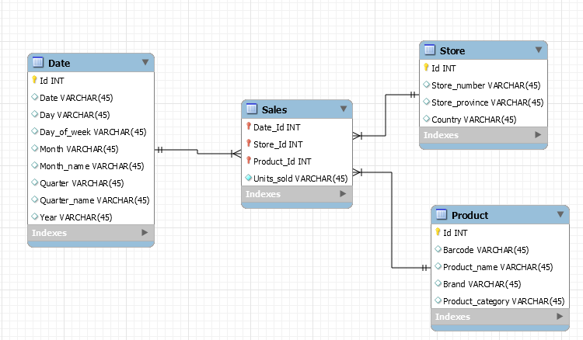
Star schema
Notes:
Sales = fact
Date = dimension
Store = dimension
Product = dimension

Slide 50
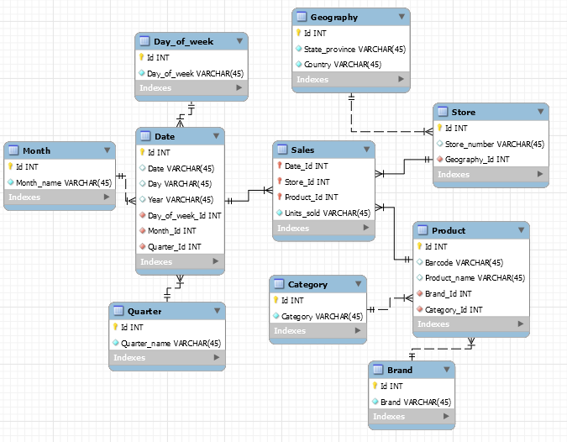
Snowflake schema
Notes:
Snowflake schema means that the dimension tables may end up with some degree of normalisation, the fact table remains the same, but we now add more of the benefits of normalisation to improve data redundancy

Slide 51
Conclusion
More questions?
Please fill in the evaluation form
http://evaluation.qa.com/

Slide 52
Thank you
QA hopes you enjoyed your course,
as much as we enjoyed teaching you.

